Slide 1
Battle of the neighbourohods
Carl’s coffee shop

Slide 2
Introduction
Carl is living in Stockholm and is a big fan of high quality coffee and has great distain for the big coffee chains and their watery coffee. So he’s planning on creating his own chain of take-away coffee shops, with only high quality coffee in environmentally friendly take away cups. For this he needs to find a location. Seeing as Carl will sell take-away coffee, the location needs to be in a place with a lot of people in movement.
One type of place where people are always on the move are metro stations. Usually these are already occupied by one or more venues selling coffee. So our mission is to find tube entrances where there are no coffee shops/cafes in the viscinity, to make sure there is not too much competition.

Slide 3
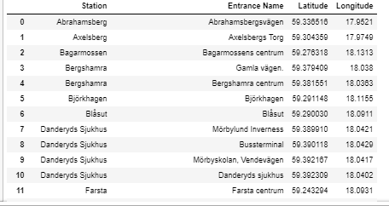
Data – Metro Entrances

Slide 4
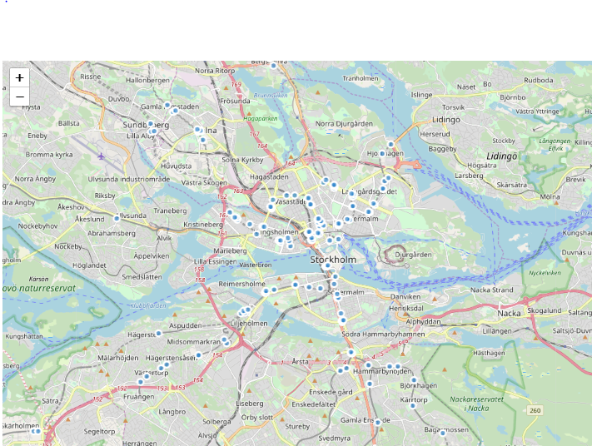
Metro Stations - Map

Slide 5
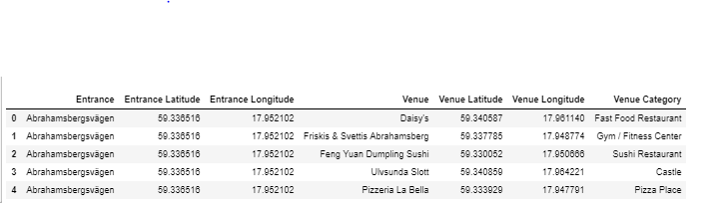
Foursquare Data
11,885 Venues
249 Unique Venues Categories

Slide 6
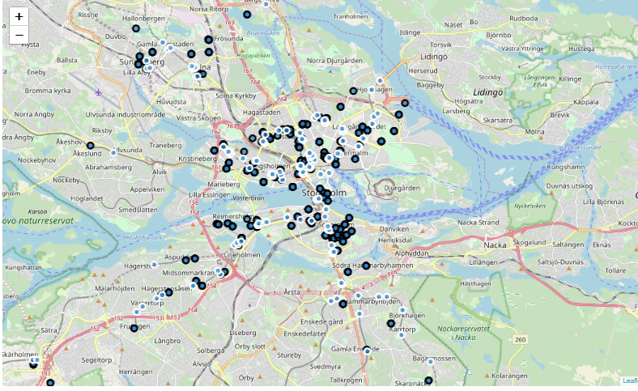
Metro Entrances & Coffee Shops @ Map

Slide 7
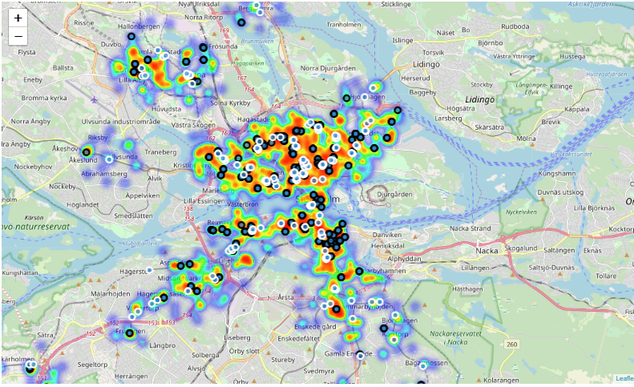
Adding heat!

Slide 8
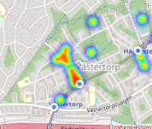
Carl’s first location!

